Slide 1

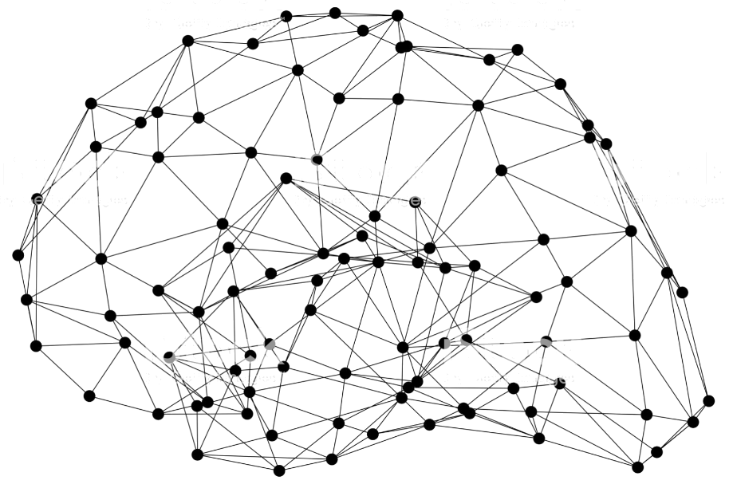
GluonCV: Pose Estimation
Notes:
First call deck for a high level introduction to Apache MXNet.

Slide 2
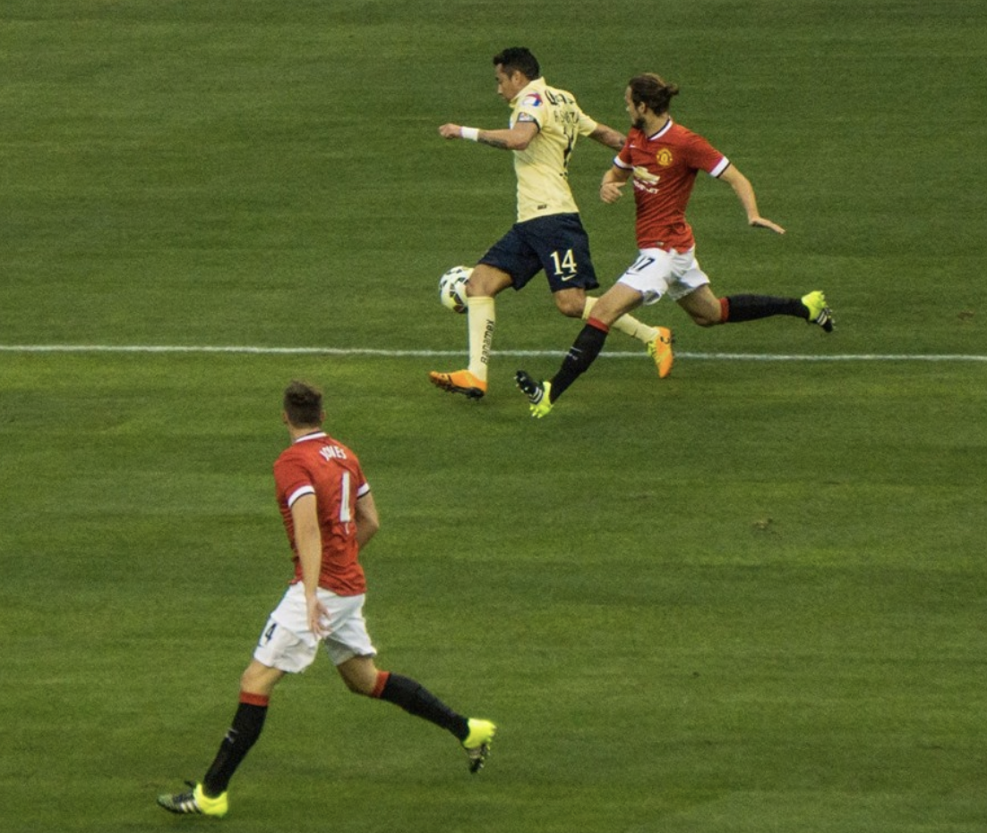
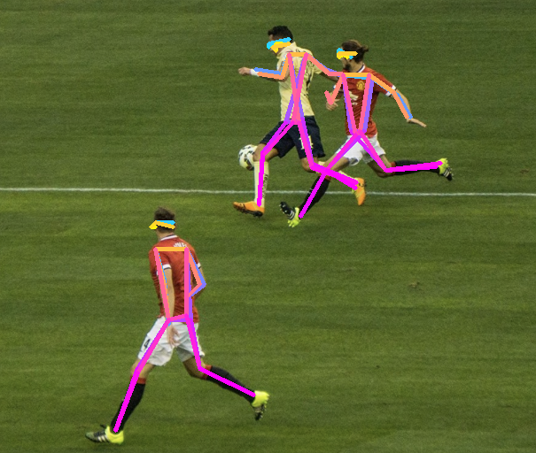
What’s Pose Estimation
Predict joint keypoints for humans in the image

Slide 3
Why Pose Estimation?
Pose helps to understand actions

Slide 4
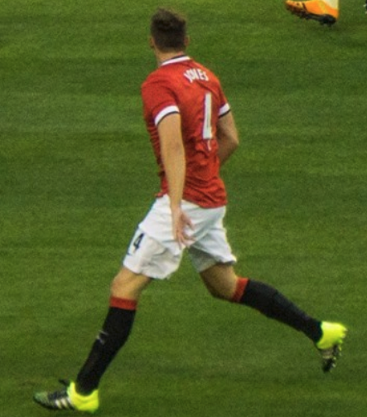

Pose Estimation Scenarios
Single-Person Pose Estimation v.s. Multi-Person Pose Estimation
Heatmap prediction
Bottom-up v.s. Top-down

Slide 5
Single-Person to Multi-Person
Top-down, more accurate
Detect human candidates by an off-the-shelf detector
Perform Single-Person Pose Estimation on each candidate
Quality depends on the detector
Inference time proportional to number of detected human
Bottom-up, faster
Detect joints for all person
Assemble joints from the same person
May produce disconnected parts of pose
May propagate mistakes across different persons.

Slide 6
Single-Person Pose Estimation
Predict heatmap instead of coordinates

Slide 7
Single-Person Pose Estimation
Each output channel predicts heatmap for a joint

Slide 8
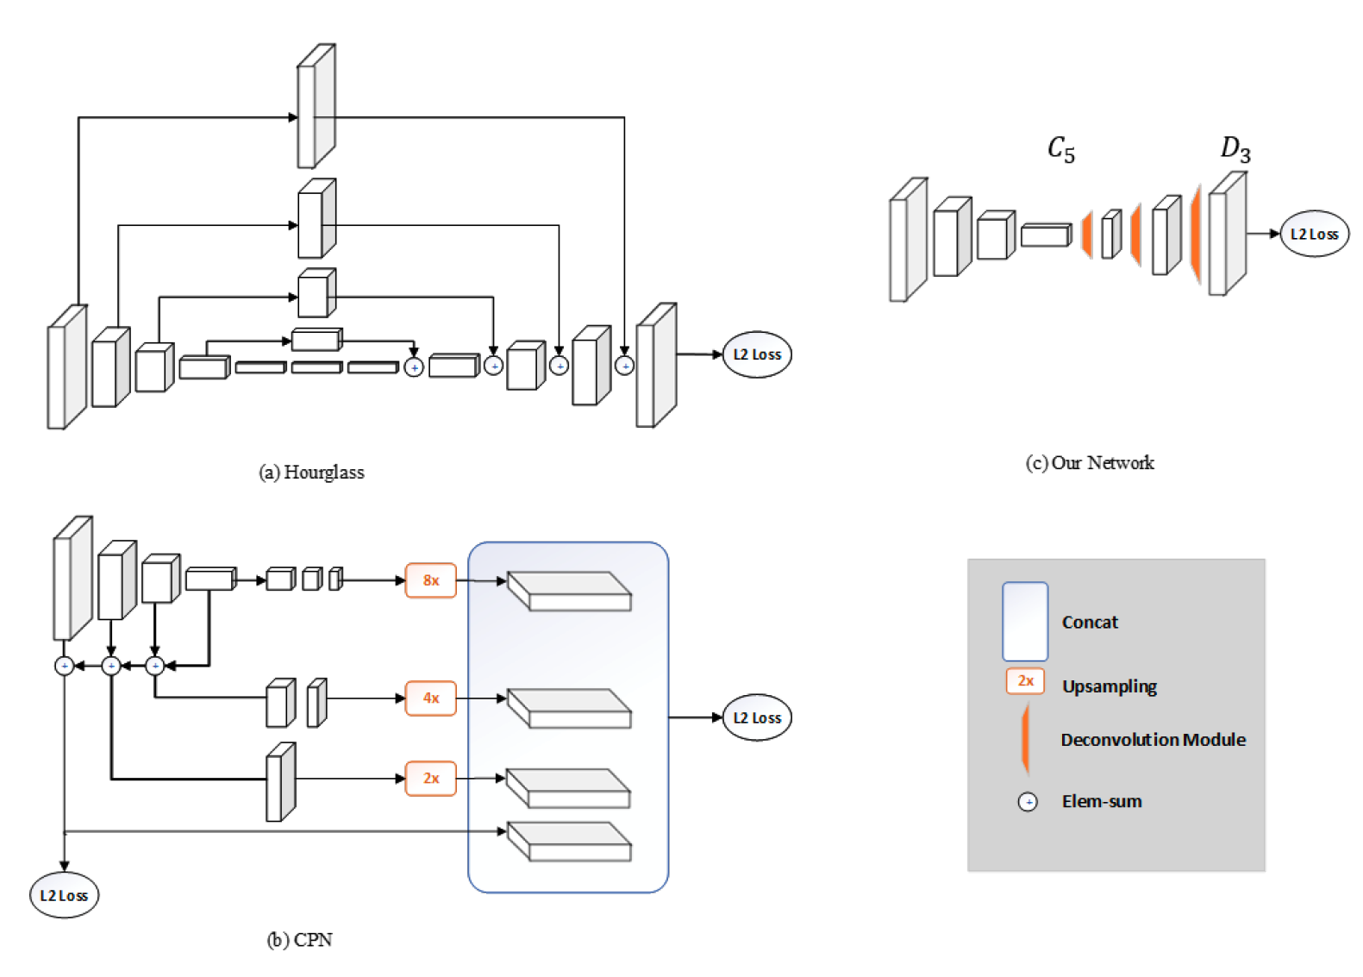
Single-Person Pose Estimation

Slide 9
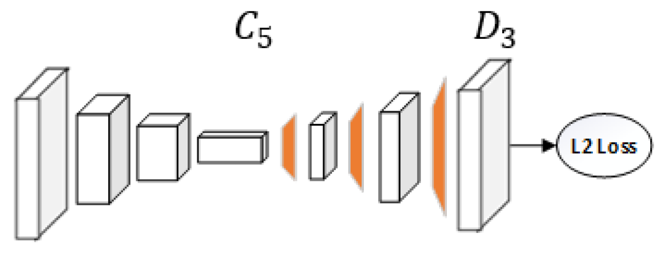
Implement SOTA SPPE Models
Simple Baselines for Human Pose Estimation and Tracking

Slide 10
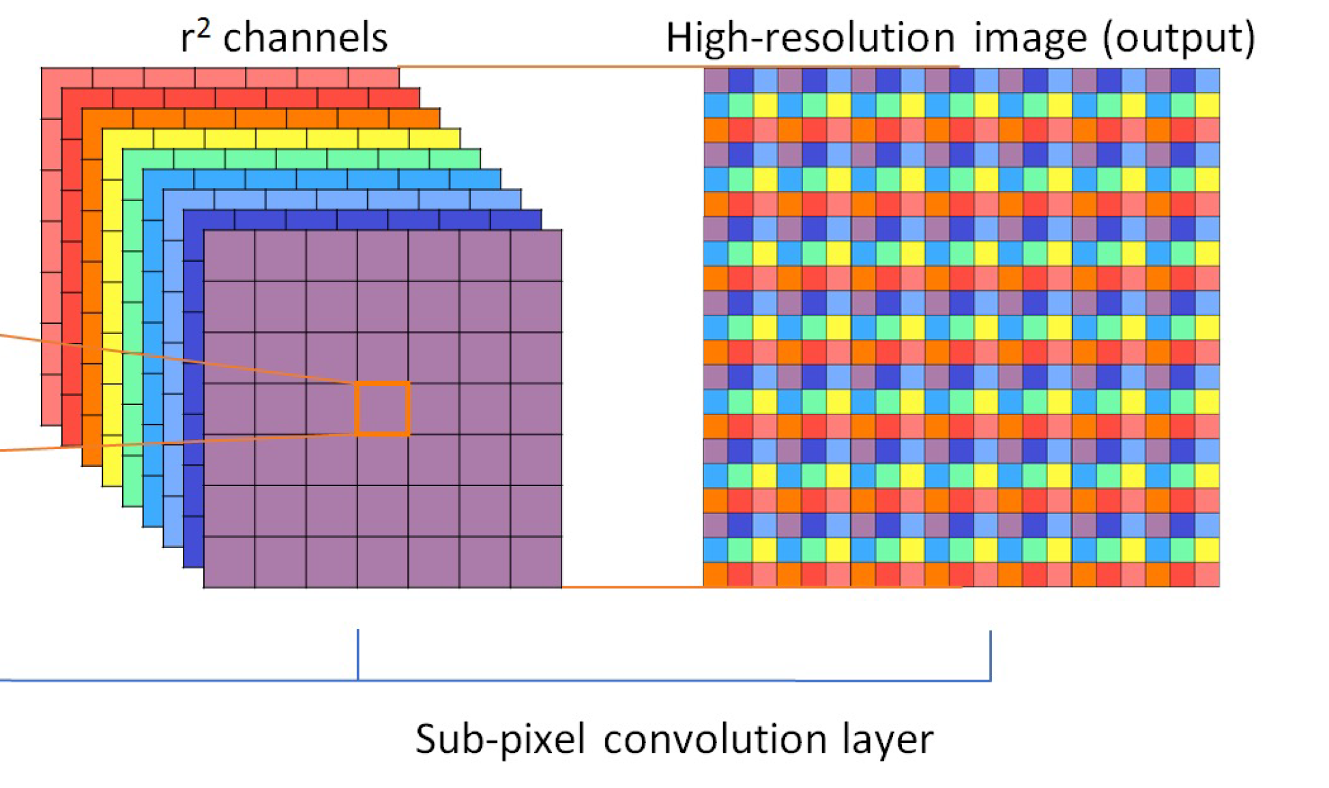
Implement SOTA SPPE Models
Real-Time Single Image and Video Super-Resolution Using an Efficient Sub-Pixel Convolutional Neural Network

Slide 11
Implement SOTA SPPE Models
Pixel Shuffle

Slide 12
Single-Person to Multi-Person
The straight-forward way

Slide 13
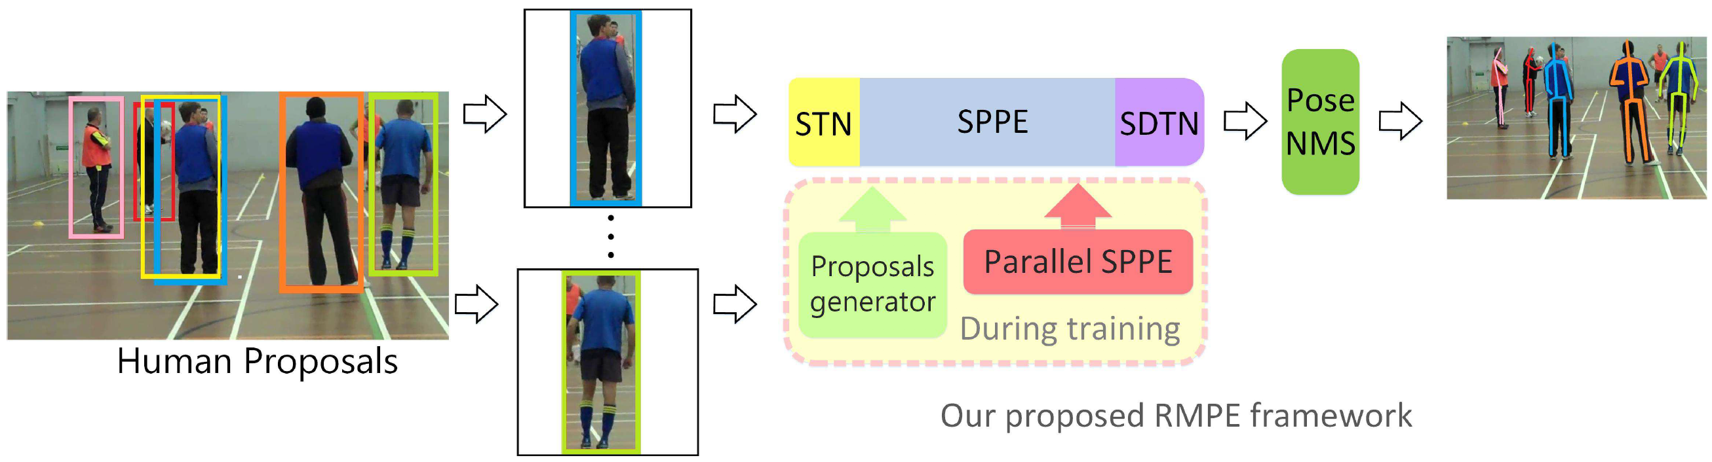
Single-Person to Multi-Person
AlphaPose

Slide 14
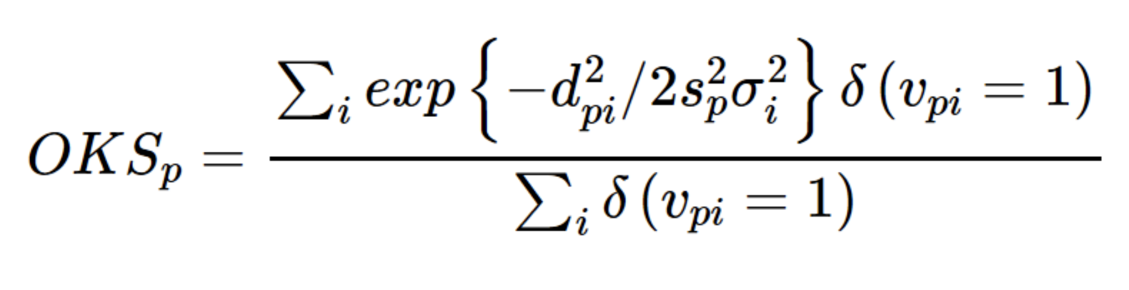
Metric: OKS
Object Keypoint Similarity
Can be seen as “IoU” in keypoint detection

Slide 15
Implement SOTA Segmentation Models with GluonCV
Method | Backbone | Metric | GluonCV
SimplePose | ResNet50 | OKS | 71.0%
MobilePose | ResNet50 | OKS | 71.1%
AlphaPose | ResNet101 | OKS | 74.2%
SOTA pre-trained models

Slide 16
Implement SOTA Segmentation Models with GluonCV
Data API
Automated data preparation
COCO Keypoint Dataset
Transformation API
Loss API
Pre-defined network architectures
Building-blocks
Custom Layers
Reproducible Experiments
Training Script
Configurations
Available in GluonCV

Slide 17
Hands On!

Slide 18

Like GluonCV? Go build!
https://github.com/dmlc/gluon-cv
https://gluon-cv.mxnet.io

